Slide 1
JAVASCRIPT
The language that drives the web

Slide 2
JAVASCRIPT
🔹 JavaScript is the most popular programming language according to research (e.g., RedMonk, Stack Overflow surveys). 👉 Frontend – HTML/CSS manipulation, animations, UI/UX improvements. 👉 Backend – Node.js allows JavaScript to run on servers. 👉 Mobile apps – React Native allows you to develop mobile apps using JavaScript.
🔹 Java vs JavaScript? – They have about as much in common as the emperor (car) and carpet. 🔹 JavaScript is an interpreted language – It is executed line by line in the browser. 🔹 Java is a compiled language – It is first compiled into an executable file, then it is run. 🔹 Why "Java" in JavaScript? – In the 90s, the name Java was popular, so Netscape took advantage of that popularity.
Notes:
https://github.com/rwaldron/idiomatic.js – kako pisati dobar javascript kod.
📌 Kratka Povijest Web Preglednika
🔹 Netscape Navigator – Dominirao web preglednicima 90-ih godina. 🔹 Internet Explorer – Glavni konkurent, izazvao „rat preglednika“. 🔹 Mosaic – Prethodnik Netscapea, jedan od prvih preglednika. 🔹 Firefox – Nastao iz ostataka Netscapea, donio inovacije.
Marc Andreessen, jedan od ključnih ljudi iza Netscapea, imao je viziju dinamičnog weba, a kako bi to omogućio, bilo je potrebno razviti novi skriptni jezik koji bi radio u pregledniku.
📌 Nastanak JavaScripta
🔹 1995. godine – Web stranice su bile statične, a sav posao obrade podataka odvijao se na serveru. 🔹 Netscapeov tim – Želio je dinamičan web s animacijama i interakcijom u pregledniku. 🔹 Brendan Eich – Unajmljen da razvije skriptni jezik, kreirao JavaScript za samo 10 dana! 🔹 Prvotni naziv – JavaScript se u početku zvao LiveScript, ali zbog popularnosti Jave, ime je promijenjeno.
📌 Što Se Događa Ako Isključimo JavaScript?
🔹 Twitter bez JavaScripta – Ne može prikazati brojač znakova kod tvitanja. 🔹 YouTube i Netflix – Ne rade uopće bez JavaScripta. 🔹 New York Times bez JavaScripta – Sajt se učitava bez oglasa jer su oni često temeljeni na JavaScriptu.
Ovo pokazuje koliko smo danas ovisni o JavaScriptu – bez njega, internet ne bi bio isti!

Slide 3
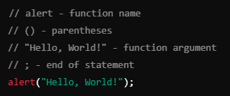
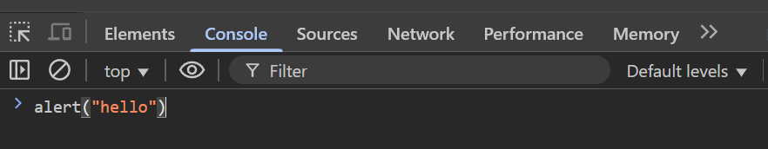
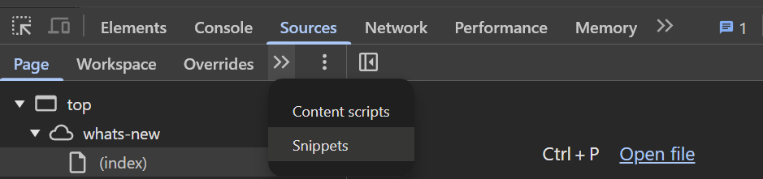
JAVASCRIPT – FIRST STEPS
👉 We can use double ("") or single ('') quotation marks for text. 👉 Recommendation: Double quotes for text data in JavaScript. 👉 Developers should follow the same writing styles for readability.

Slide 4
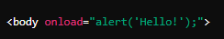
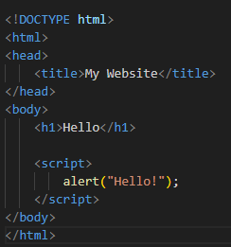
JAVASCRIPT – INTEGRATION
Inline Javascript
Intern Javascript
👉 Bad practice! 👉 Difficult to maintain and debugging. 👉 It's inseparable from HTML.
👉 Better than inline JavaScript, but still not optimal for larger projects.

Slide 5
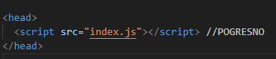
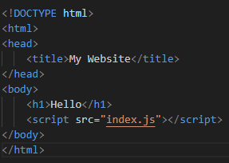
JAVASCRIPT – INTEGRATION
Extern Javascript
👉 The JavaScript will run before the HTML is loaded. 👉 If the script tries to change HTML elements that have not yet been loaded, we will get an error.
👉 Better code organization 👉 Easier maintenance 👉 Better performance 👉 Allows caching, which speeds up page loading 👉 The page works faster by displaying the content first, then running javascript

Slide 6
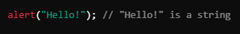
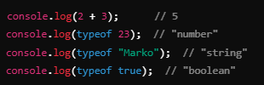
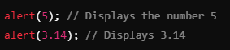
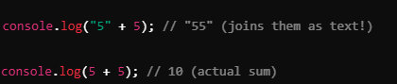
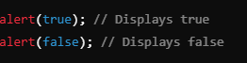
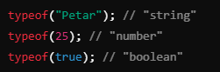
JAVASCRIPT – INTEGRATION
Exercise
👉 String
👉Numbers
👉 Boolean (true/false)
👉 They allow us to use the data in the program correctly. 👉 They prevent errors – we cannot, for example, add a string and a number:
👉 How the browser recognizes

Slide 7
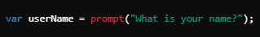
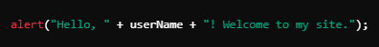
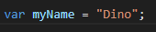
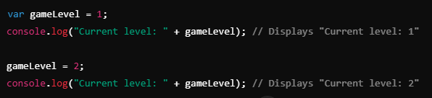
JAVASCRIPT – VARIABLE
👉They allow data to be reused without repeating the code. 👉 They help organize the program. 👉 They allow you to customize and change data during program execution.
Exercise
👉 Declaration
👉 Change in value

Slide 8
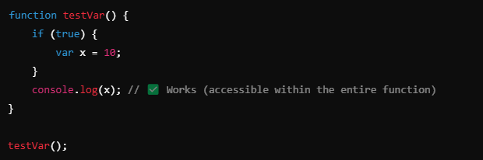
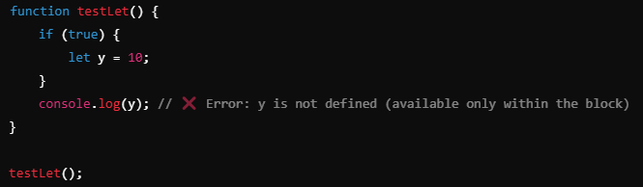
JAVASCRIPT – VARIABLE
VAR
LET
👉Variables defined using var are available within the entire function in which they are declared, even before the declaration itself.
👉Variables defined using let are only available within the block {} in which they are defined.

Slide 9
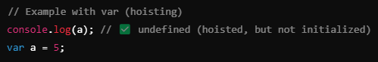
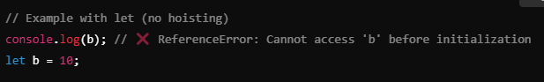
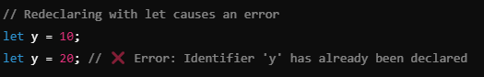
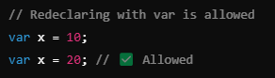
JAVASCRIPT – VARIABLE
VAR
LET
👉VAR is "hoisted" to the top of its function, but initialized as undefined.
👉let is also raised, but it is not initialized, so if you access it before declaring, you get a ReferenceError.
👉VAR allows the same variable to be redeclared within the same scope.
👉let does not allow re-declaration within the same scope.

Slide 10
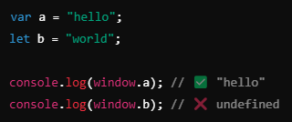
JAVASCRIPT – VARIABLE NAMING
VAR
LET
👉VAR becomes a property of the window object.
👉let it doesn't.
💡Use let instead of var to better control the reach and avoid unexpected behavior due to hoisting.

Slide 11
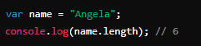

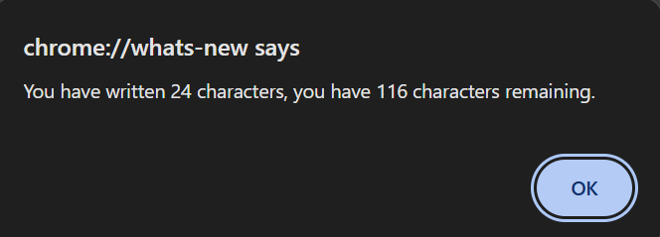
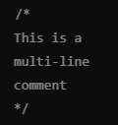
JAVASCRIPT – LENGTH
👉length tells us how many characters a string has. 👉Useful for checking character limits (e.g. for tweets)
Exercise
Write a code that: ✔ It allows the user to enter text. ✔ Calculates the number of characters. ✔ Shows how many characters are left (max: 140).
Code commenting

Slide 12
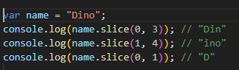
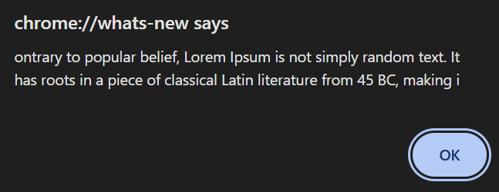
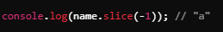
JAVASCRIPT – SLICE
👉slice(start, end) takes the part of the string from start to end (not including end). 👉 It is useful for limiting entries (e.g. the number of characters in a tweet)
Exercise
Write a code that: ✔ It allows the user to enter text. ✔ Shorten text to 140 characters. ✔ Display shortened text using alert().
👉Example of how to draw the last character

Slide 13
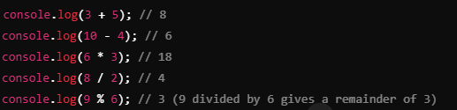
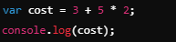
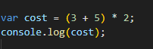
JAVASCRIPT – MATHEMATICS
Mathematicians operators
Exercise
Write a code that: ✔ 1. Prompt input from the user using prompt(). ✔ 2. Calculate the human years according to the formula. ✔ 3. Display the result using alert().
Sequence of operations
👉First, multiplication * and division / are performed, then addition + and subtraction -. ✔ 👉 If we want to change the order, we use parentheses ().

Slide 14
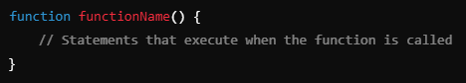
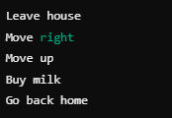
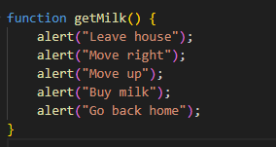
JAVASCRIPT – FUNCTIONS
👉We use it to avoid repeating the code. 👉 We call her only when we need her
Exercise
Write a code that: ✔ 1. Returns the text shown below as a log instead of an aler

Slide 15
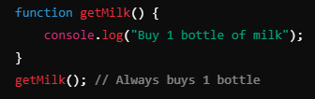
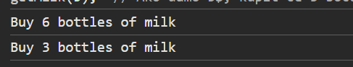
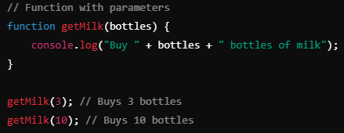
JAVASCRIPT – FUNCTIONS
👉 Parameters allow a function to receive input and use it within its code 👉 Without parameters, the function always works the same – with parameters we can change its outcome!
Exercise
✔ The function should receive the amount of money. ✔ Calculates how many bottles of milk you can buy (1 bottle = $1.5). ✔ It shows how many bottles he can buy.

Slide 16
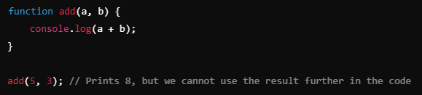
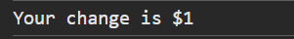
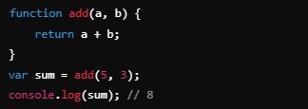
JAVASCRIPT – FUNCTIONS
👉 Return allows the function to return a value that can be used later. 👉 The No Return function performs an action, but does not return any result.
Exercise
✔ The function receives the amount of money. ✔ Calculates how many bottles of milk he can buy (1 bottle = $1.5). ✔ Returns change (money left over after purchase).

Slide 17
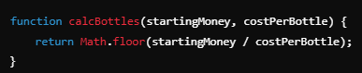
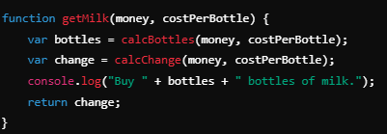
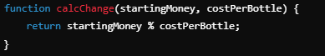
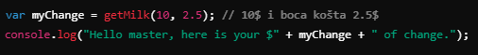
JAVASCRIPT – FUNCTIONS
💡By combining multiple functions, we improve the organization of the code!

Slide 18
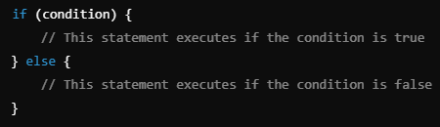
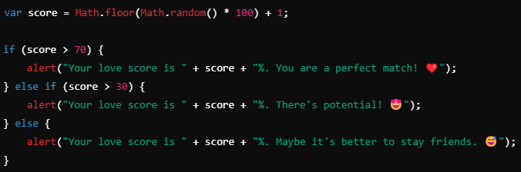
JAVASCRIPT – CONDITIONS
One condition
Multiple conditions
👉 Conditions allow you to control the flow of the program 👉 We can create advanced logics

Slide 19
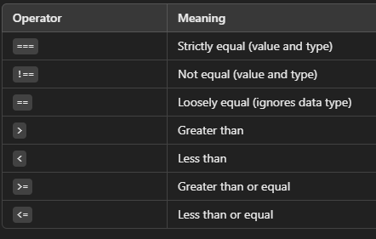
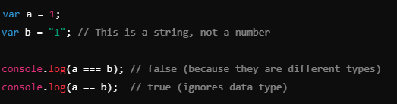

JAVASCRIPT – COMPARATORS
👉 Always use === for precise checks
💡By combining comparison operators, we can make more complex logic.

Slide 20




JAVASCRIPT – LOGICAL OPERATORS
👉 Logical operators allow you to check multiple conditions at once.

Slide 21

JAVASCRIPT – DOM
Document object model
👉 DOM is a website model that allows JavaScript to modify HTML and CSS in real-time. 👉 When the page loads, the browser converts HTML into a DOM object that we can select and manipulate.

Slide 22

JAVASCRIPT – DOM
👉 Allows you to change HTML elements (text, color, content...) 👉 Interaction with the user (clicks, typewriter, input fields...) 👉 Automate changes without refreshing the page

Slide 23



JAVASCRIPT – DOM
Exercise
✔ Select the third <li> element and change its text to your name (WITHOUT changing the HTML)!
👉Changing HTML Elements
👉changing CSS styles
👉simulates click na checkbox.

Slide 24



JAVASCRIPT – DOM
Exercise
✔ Change the color of the Google link using JavaScript
💡querySelector() and querySelectorAll() are the most powerful because they can select IDs, classes, and tags at the same time.

Slide 25

JAVASCRIPT – FINAL EXERCISE
Add JavaScript functionality to the existing EduHence Classroom Management website. The goal is to add dynamic behavior to the form and table so that students can interact with the site.
Task Instructions:
Add Dynamic Form Handling:
Create a JavaScript function that adds a new student to the table when the form is submitted.
After submission, the form fields should clear automatically.
Add Delete Button:
Add a delete button next to each student in the table.
When the delete button is clicked, the student should be removed from the table.
Add Filtering:
Add a search input that allows students to filter the table by student name.
The table should update dynamically as the user types.
Validation:
Ensure that the form fields are filled before adding a new student.
Display an alert or error message if the form is incomplete.
Update on GitHub:
Once you’ve added the functionality, commit and push the updated code to your GitHub repository.

